Slide 1
Software Engineering Project Group 5
Final presentation
LEONARD Tom and VILLIERE Lucas

Slide 2
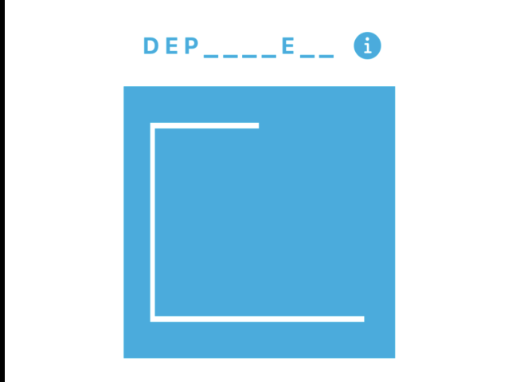
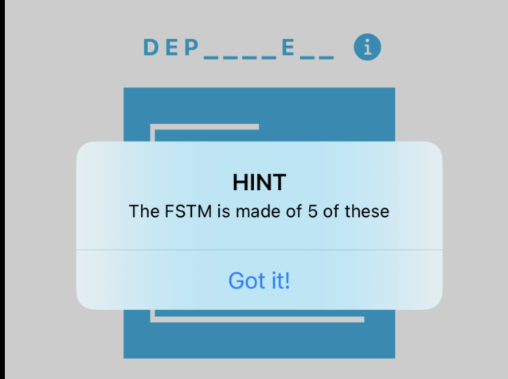
Hangman Fully Operational

Slide 3

Final logo for our app !

Slide 4
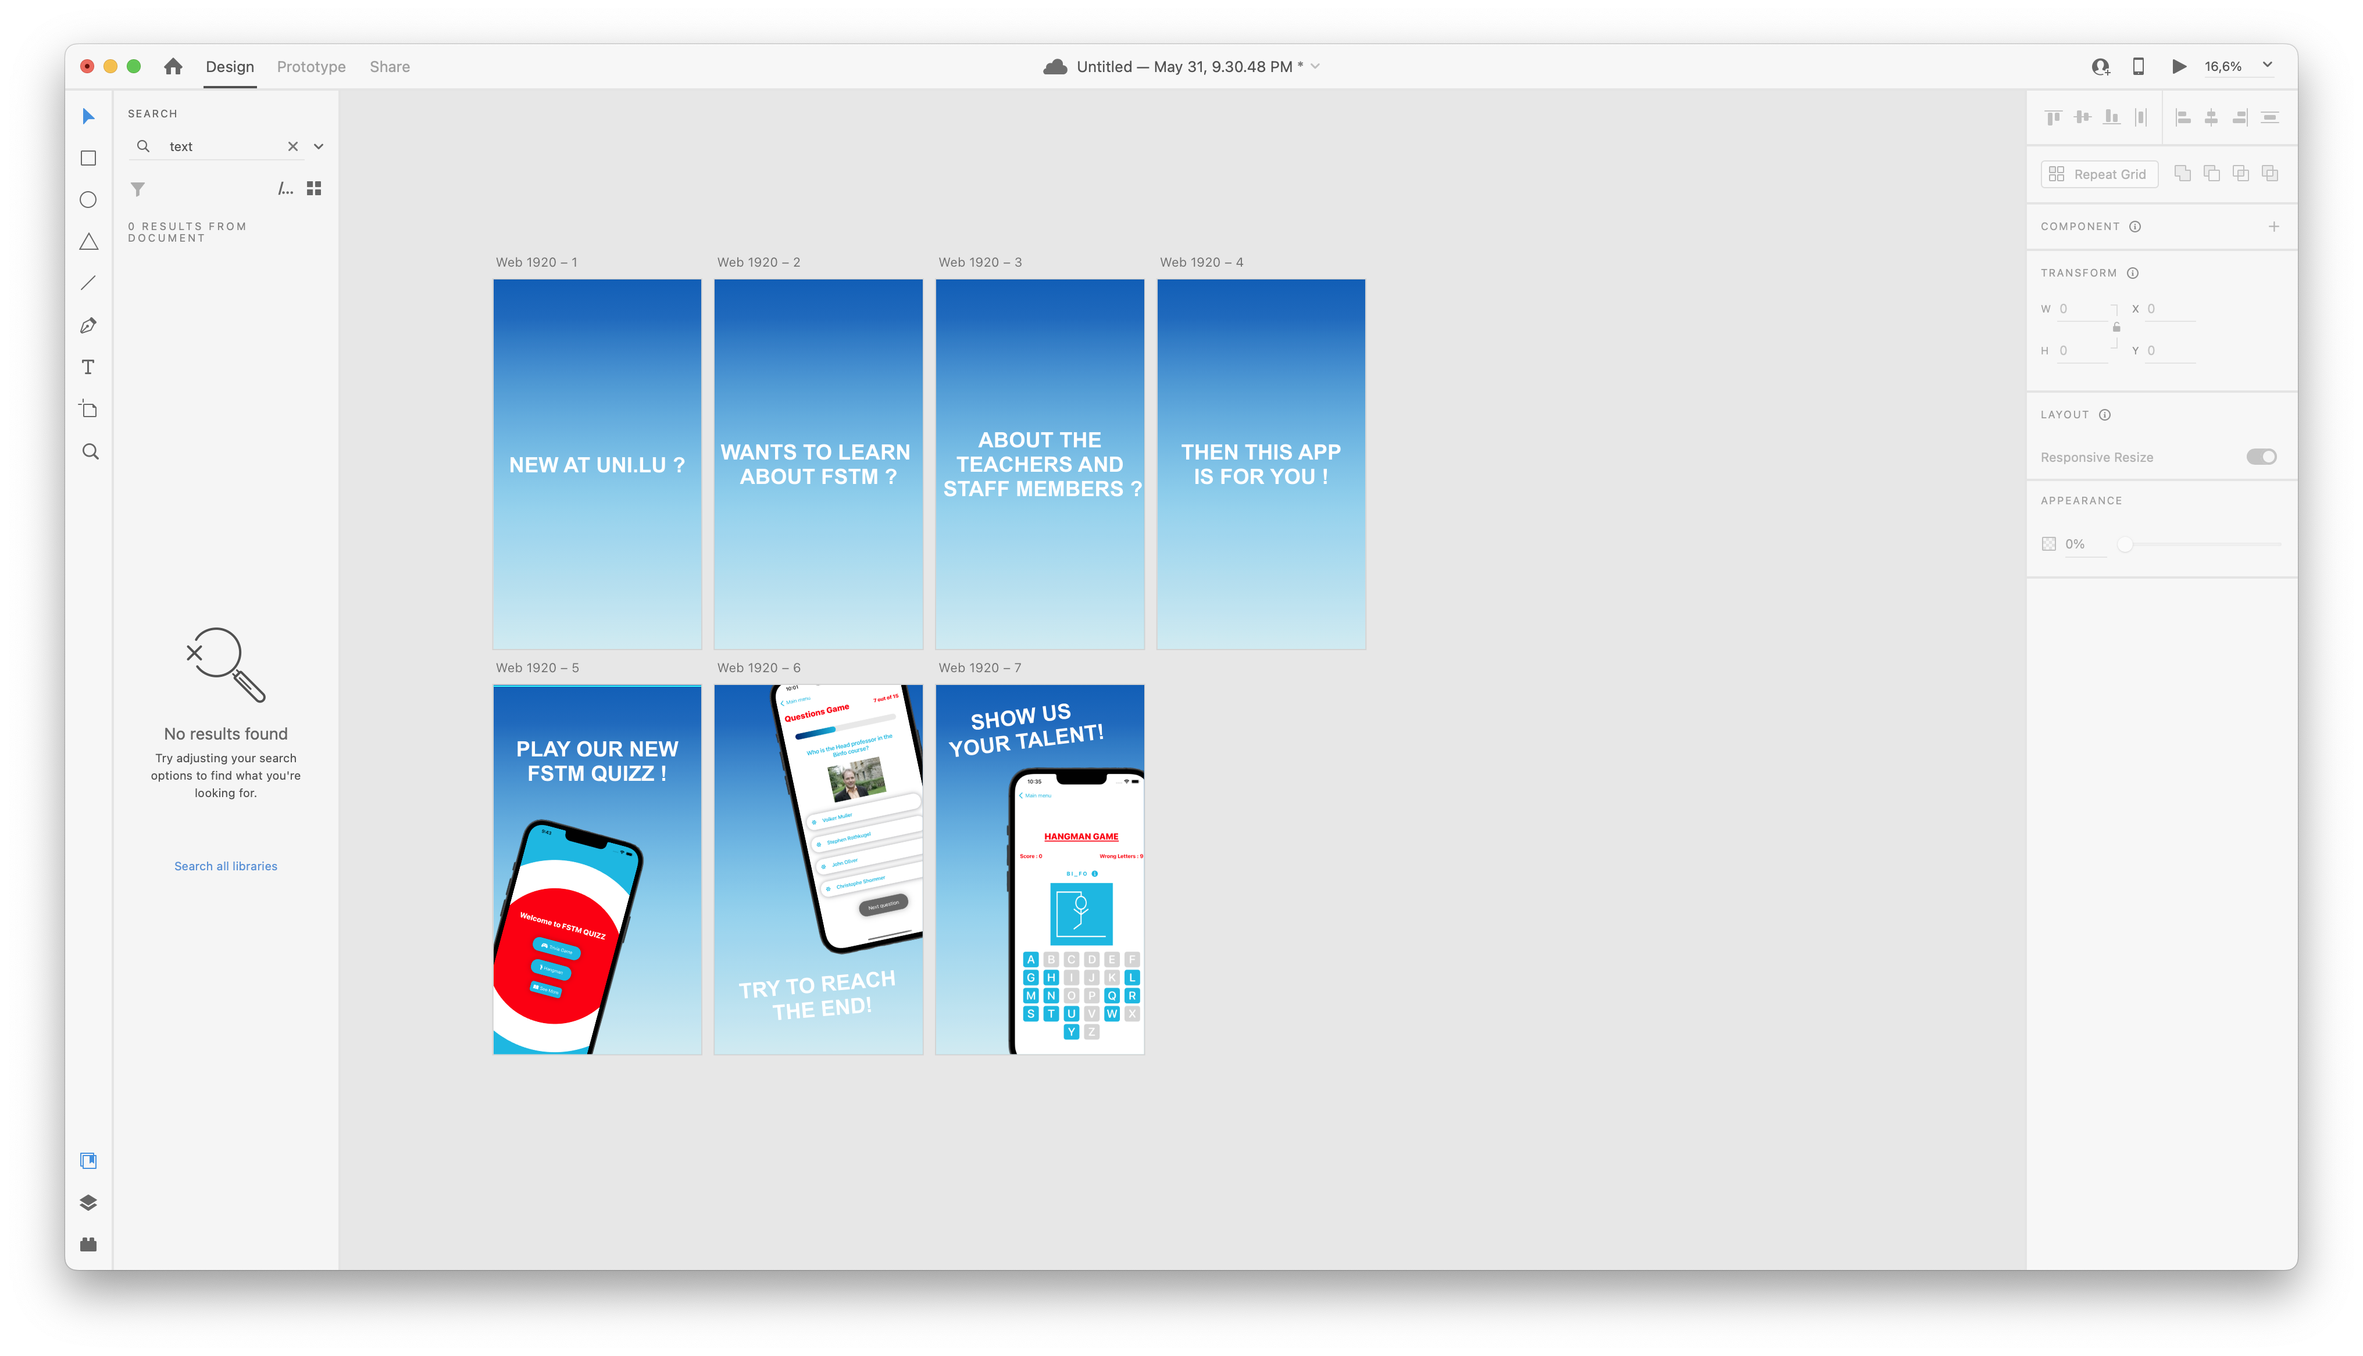
First sample of our video using adobe xD

Slide 5
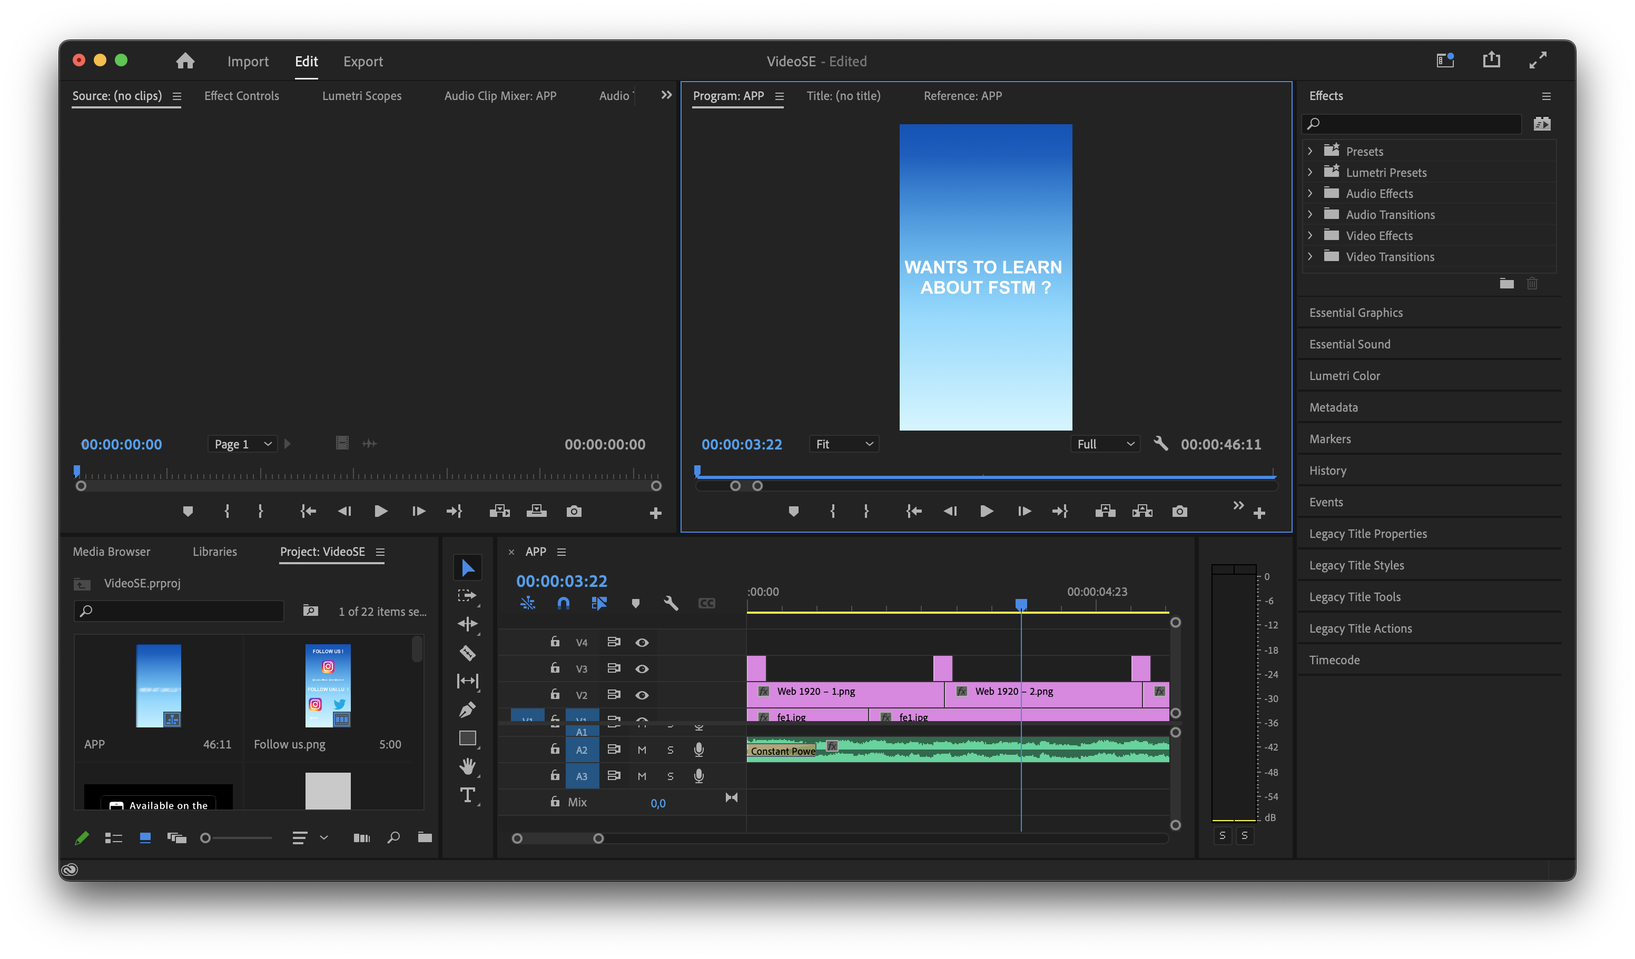
video editing using premiere pro

Slide 6

Commercial Video

Slide 7
Final thoughts on the project
Time management
Good idea
Appreciate the freedom

